Slide 1
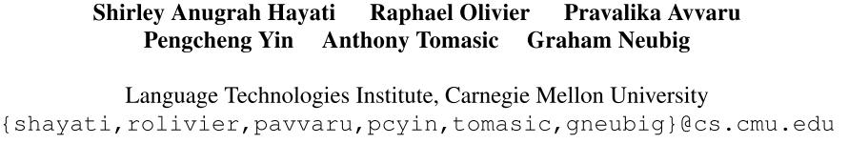
Retrieval-Based Neural Code Generation
EMNLP-2018

Slide 2
Introduction
Natural language to code generation, a subtask of semantic parsing, is the problem of converting natural language (NL) descriptions to code.
Sequential approaches
Convert the target code into a sequence of symbols and apply a sequence-to-sequence model, but this approach does not ensure that the output will be syntactically correct.
Tree-based approaches
Represent code as Abstract Syntax Trees (ASTs), representing code as a tree is not a trivial task, as the number of nodes in the tree often greatly exceeds the length of the NL description.
Incapable of generating correct code for phrases in the corresponding NL description that have low frequency in the training data

Slide 3
Introduction
In machine translation (MT) problems, hybrid methods combining retrieval of salient examples and neural models have proven successful in dealing with rare words.
We propose RECODE, and adaptation of Zhang et al. (2018)’s [1] retrieval-based approach neural MT method to the code generation problem by expanding it to apply to generation of tree structures.
[1] Guiding Neural Machine Translation with Retrieved Translation Pieces (NAACL-2018)

Slide 4
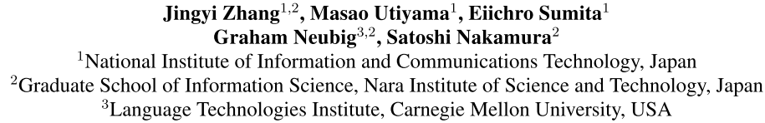
Guiding Neural Machine Translation with Retrieved Translation Pieces
NAACL-2018

Slide 5
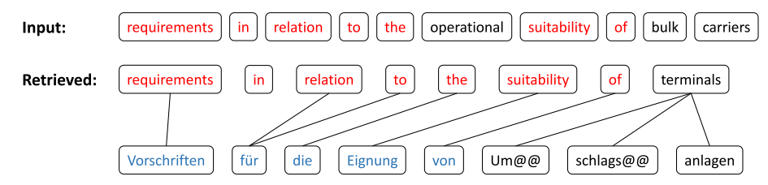
Introduction
One of the difficulties of neural machine translation (NMT) is the recall and appropriate translation of low-frequency words or phrases.
Augments NMT using retrieval-based models, retrieving sentence pairs from the training corpus that are most similar to the sentence that we want to translate, and then using these to bias the NMT model.
translation pieces
Notes:
Up-weight NMT outputs that contain the collected translation pieces. Unlike the previous methods, this requires no change of the underlying NMT model and no updating of the NMT parameters, making it both simple and efficient to apply at test time.

Slide 6
Guiding NMT with Translation Pieces
Base Model
Seq2seq with attention mechanism
Guiding NMT with Translation Pieces
Retrieving candidate translation pieces from a parallel corpus for the new source sentence that we want to translate.
Using the collected translation pieces to guide an existing NMT model while translating this new sentence.

Slide 7
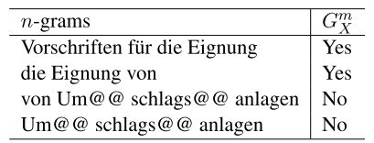


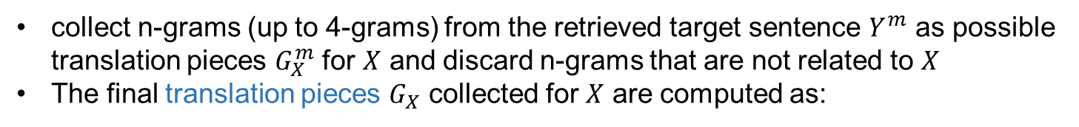
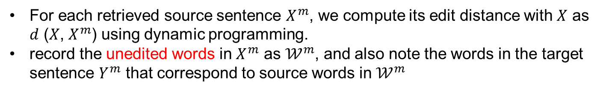


Guiding NMT with Translation Pieces
Retrieving Translation Pieces
input sentence: $X$
For each retrieved source sentence $X^{m}$, we compute its edit distance with $X$ as $d$ ($X$, $X^{m}$) using dynamic programming.
record the unedited words in $X^{m}$ as $𝒲^{m}$, and also note the words in the target sentence $Y^{m}$ that correspond to source words in $𝒲^{m}$
Lucene
$X^{m}$ : 1 ≤ m ≤ M
collect n-grams (up to 4-grams) from the retrieved target sentence $Y^{m}$ as possible translation pieces $G_{X}^{m}$ for $X$ and discard n-grams that are not related to $X$
The final translation pieces $G_{X}$ collected for $X$ are computed as:
$Y^{m}$ : 1 ≤ m ≤ M
Notes:
use the off-the-shelf search engine Lucene to search the word-aligned parallel training corpus and retrieve M source sentences {Xm : 1 ≤ m ≤ M} that are similar to X.

Slide 8
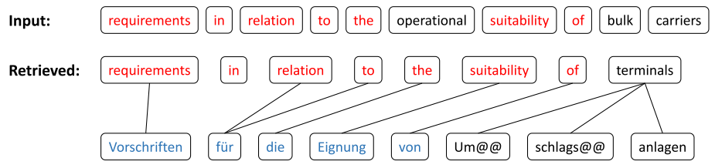
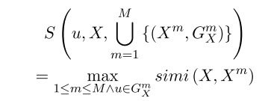

Guiding NMT with Translation Pieces
Retrieving Translation Pieces
However, when a retrieved source sentence is not very similar with the input sentence, the translation pieces collected from its target side will be less likely to be correct translation pieces for the input sentence.
Compute a score for each u ∈ $G_{X}$ to measure how likely it is a correct translation piece for X based on sentence similarity between the retrieved source sentences and the input sentence as following

Slide 9
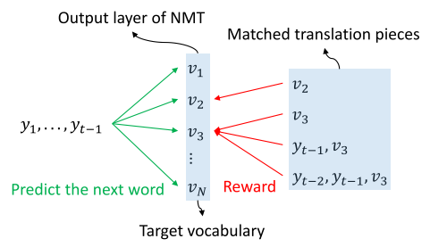
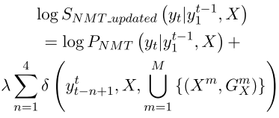
Guiding NMT with Translation Pieces
Guiding NMT with Retrieved Translation Pieces
Add an additional reward for n-grams that occur in the collected translation pieces.
At each time step t, we update the probabilities over the output vocabulary and increase the probabilities of those that result in matched n-grams according to
where $λ$ can be tuned on the development set and $δ(∙)$ is computed as Equation (1) if $y_{t−n+1}^{t}∈G_{X}$,
otherwise$δ(∙)$ = 0
(1)
Notes:
如果某个词和之前生成的词构成的n-gram和translation pieces匹配的话就增加它的概率

Slide 10
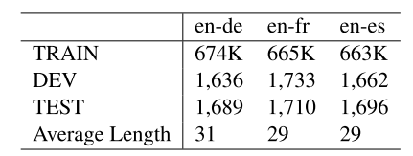
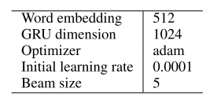
Experiment
Dataset
Following Gu et al. (2017) [1], we use version 3.0 of the JRC-Acquis corpus for our translation experiments.
English-to-German (en-de), English-to-French (en-fr) and English-to-Spanish (en-es)
Settings
removed sentences longer than 80 and 100 from the training and development/test sets respectively
applied byte pair encoding (Sennrich et al., 2016b) and set the vocabulary size to be 20K
For each input sentence, we retrieved 100 sentence pairs from the training set using Lucene as our preliminary setting.
Baselines
attentional NMT
search engine guided NMT (SGNMT) model [1]
[1] Search engine guided non-parametric neural machine translation (AAAI-2018)
Notes:
SGNMT: got their preprocessed datasets and tested our method on their datasets

Slide 11
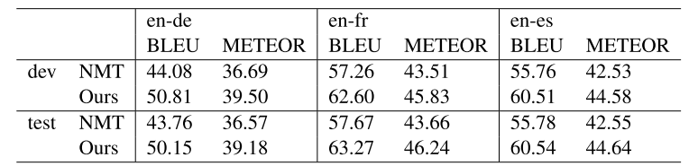
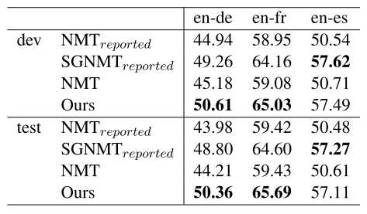
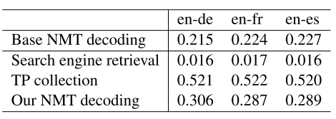
Experiment
Results
Comparison with attentional NMT
Comparison with SGNMT
Computational Considerations
Notes:
Our method only collects translation pieces to help NMT for translating a new sentence and does not influence the training process of NMT. Therefore, our method does not increase the NMT training time.

Slide 12
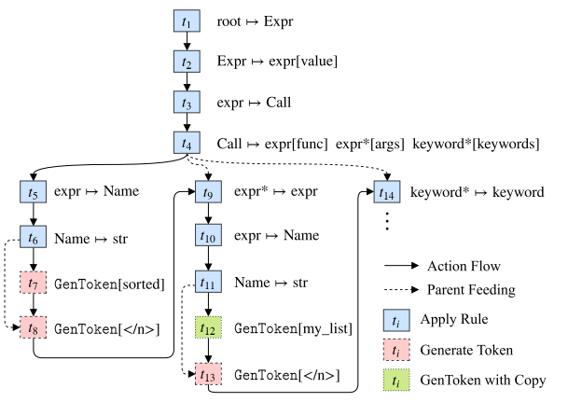
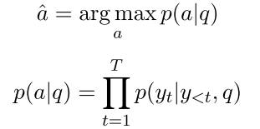
Problem Definition
Syntactic Code Generation
Given an NL description q, generate code (e.g. Python) represented as an AST a.
Actions to build an AST
APPLYRULE
GENTOKEN
A Syntactic Neural Model for General-Purpose Code Generation

Slide 13
ReCode
ReCode: Retrieval-Based Neural Code Generation
Pipeline at test:
Retrieve from the training set NL descriptions that are most similar with our input sentence
Extract n-gram action subtrees from these retrieved sentences’ corresponding target ASTs
Substituting words of the retrieved sentence with corresponding words in the input sentence
At every decoding step, increase the probability of actions that would lead to having these subtrees in the produced tree

Slide 14

ReCode
ReCode: Retrieval-Based Neural Code Generation
Retrieval of Training Instances
For every retrieved NL description qm from training set (or retrieved sentence for short), we compute its similarity with input q, using a sentence similarity formula
where d is the edit distance. We retrieve only the top M sentences according to this metric where M is a hyperparameter

Slide 15
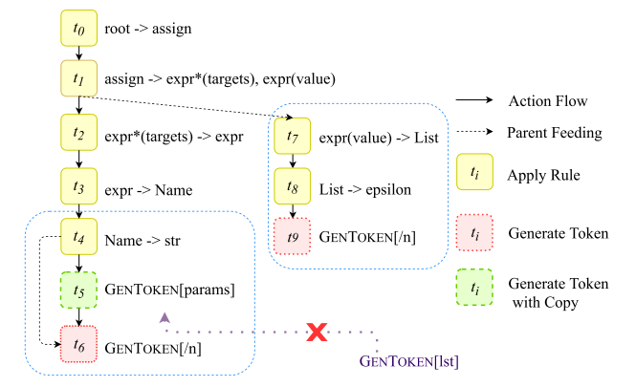
ReCode
ReCode: Retrieval-Based Neural Code Generation
Extracting N-gram Action Subtrees
In syntax-based code generation, the generation target is ASTs with no obvious linear structure. To resolve this problem, we instead use retrieved pieces of n-gram subtrees from the target code corresponding to the retrieved NL descriptions (actions).
Considered only successive actions, such as subtrees where each node has one or no children, to avoid overly rigid structures or combinatorial explosion of the number of retrieved pieces the model has to consider.
[assign → expr*(targets), expr(value) ; expr(value) → List; List → epsilon]
Notes:
we set the subtrees to have a fixed depth, linear in the size of the tree.

Slide 16
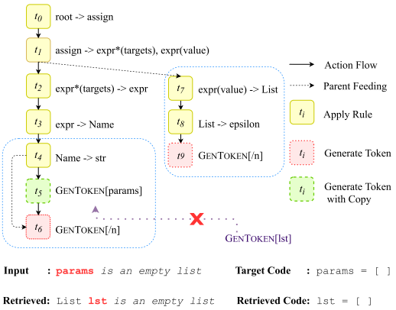
ReCode
ReCode: Retrieval-Based Neural Code Generation
Word Substitution in Copy Actions
Using the retrieved subtree without modification is problematic if it contains at least one node corresponding to a COPY action because copied tokens from the retrieved sentence may be different from those in the input.
For unaligned words, we alter all COPY rules in the extracted n-grams to copy tokens by their aligned counterpart.

Slide 17
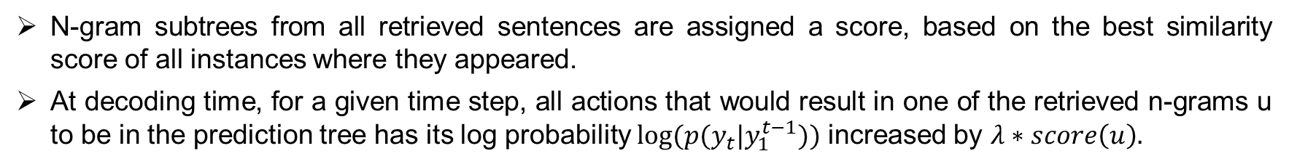
ReCode
ReCode: Retrieval-Based Neural Code Generation
Retrieval-Guided Code Generation
N-gram subtrees from all retrieved sentences are assigned a score, based on the best similarity score of all instances where they appeared.
At decoding time, for a given time step, all actions that would result in one of the retrieved n-grams u to be in the prediction tree has its log probability $log⁡(p(y_{t}|y_{1}^{t−1}))$ increased by $λ∗score\left(u\right).$

Slide 18
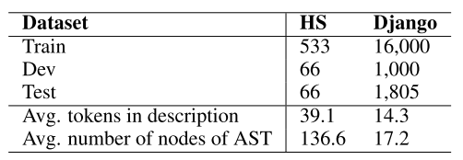
Experiments
Datasets
Hearthstone and Django
HS consists of Python classes that implement Hearthstone card descriptions while Django contains pairs of Python source code and English pseudo-code from Django web framework
Evaluation Metrics
Accuracy of exact match and the BLEU score

Slide 19
Experiments
For the neural code generation model, we use the settings explained in Yin and Neubig (2017) [1]
For the retrieval method, we tuned hyperparameters and achieved best result when we set nmax = 4 and λ = 3 for both datasets.
For HS, we set M = 3 and M = 10 for Django.
Baselines
YN17 [1]
SEQ2SEQ
Abstract Syntax Networks with supervision (ASN+SUPATT) [2]
[1] A Syntactic Neural Model for General-Purpose Code Generation
[2] Abstract Syntax Networks for Code Generation and Semantic Parsing

Slide 20
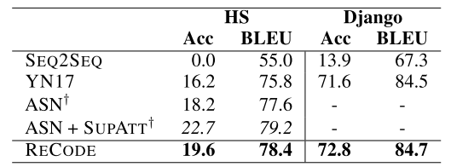
Experiments
Results
ASN+SupAtt is trained with supervised attention extracted through heuristic exact word matches while our attention is unsupervised.

Slide 21
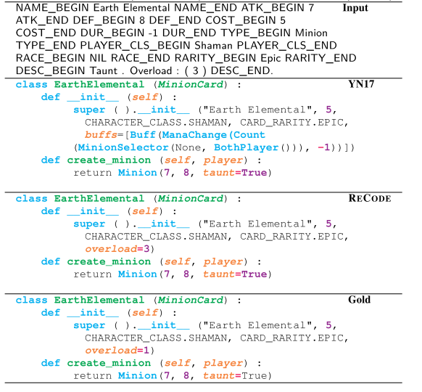
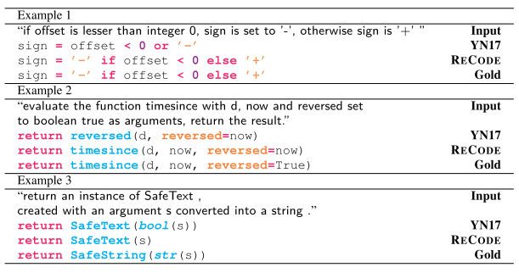
Experiments
Results
Django examples on correct code and predicted code with retrieval (RECODE) and without retrieval (YN17)
HS examples on correct code and predicted code with retrieval (RECODE) and without retrieval (YN17)
Notes:
retrieval model can handle complex code more effectively

Slide 22
Thanks !
Retrieval-Based Neural Code Generation (EMNLP-2018)
Guiding Neural Machine Translation with Retrieved Translation Pieces (NAACL-2018)

